Slide 1

BIM && YOU
Episode 00: Introduction & DEEP PURGE

Slide 2
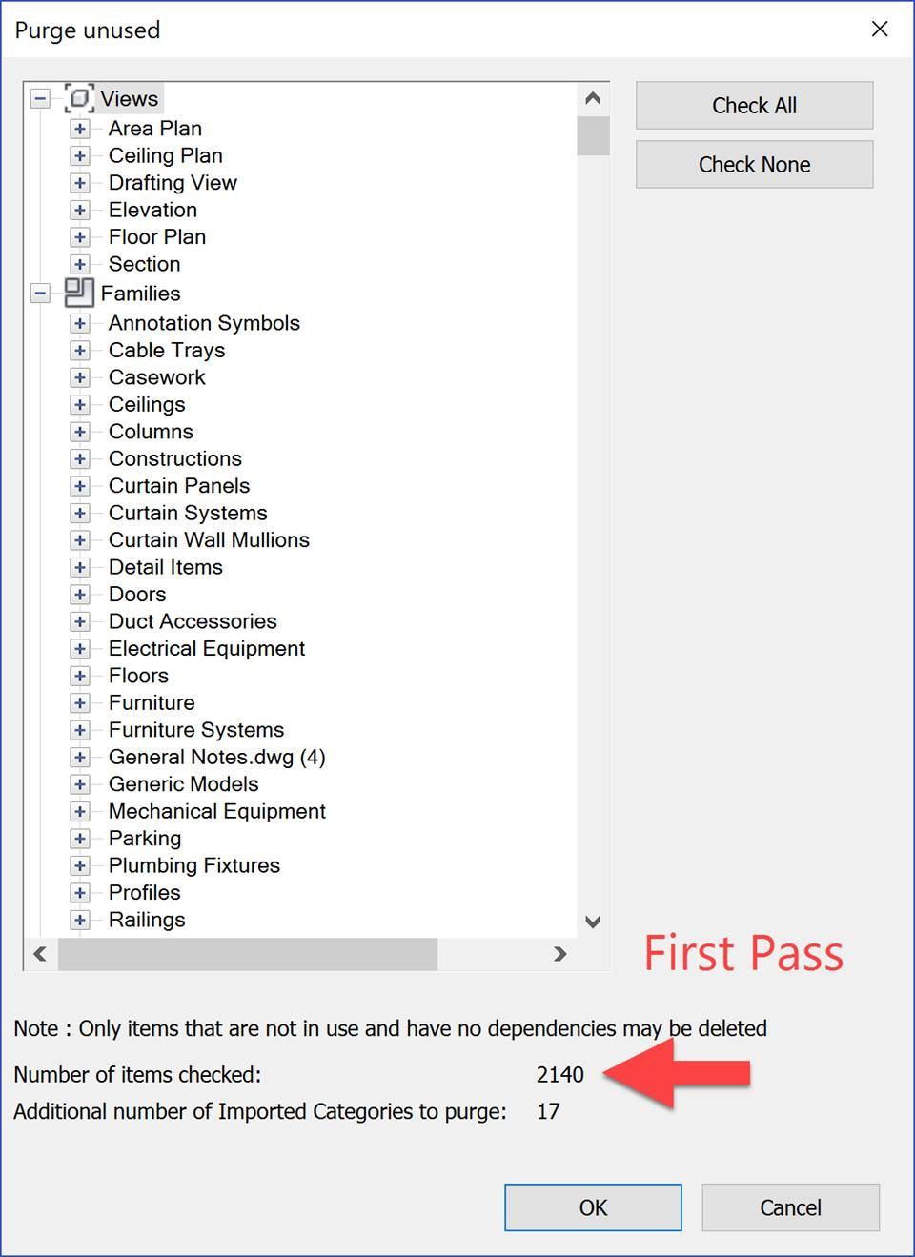
The Daily Bottleneck
■
Tedious Repetition: Manually purging every model you open
■
Wasted Processing Time: doing the same process 3+ times
■
Human Error: Manually purging every model will lead to some being missed

Slide 3





The VDC Workflow
1. Dynamo Player
2. Run the script
3. Check the result
add a shortcut for it so it fires easily in the future
simply click on the play button
check atleast one revit model

Slide 4
Coordination Impact
Focus on Coordination, Not Repetitive Tasks
99%
by simply hitting this run button in the dynamo player you do not have to worry about how long it will take to purge or how many times
Less client complaint about non-purged models

Slide 5

Grab the Workflow
Download the Dynamo script and the Presentation for this episode.
linkedin.com/in/arch-youssef
github.com/ArchYoussefAdel/BIM-and-YOU

Slide 6
Sources
https://blogger.googleusercontent.com/img/b/R29vZ2xl/AVvXsEgZ3CEJfFGx-RBsXaWCSPmBgs4QOrEhvMC1cEgGKAmlQSiueyUSmAmDMoXdFMD5UiEX1RyL7VAmYSS3O7Ea6HGvS3dwVaLWiSLkpgdO-tNsAYU255KHiA7gHLA7Vah5idxVA2dWB6t7dJyG/s1600/Im03.jpg

Slide 7
BIM && YOU
Episode 01: Creating a Coordination View

Slide 8
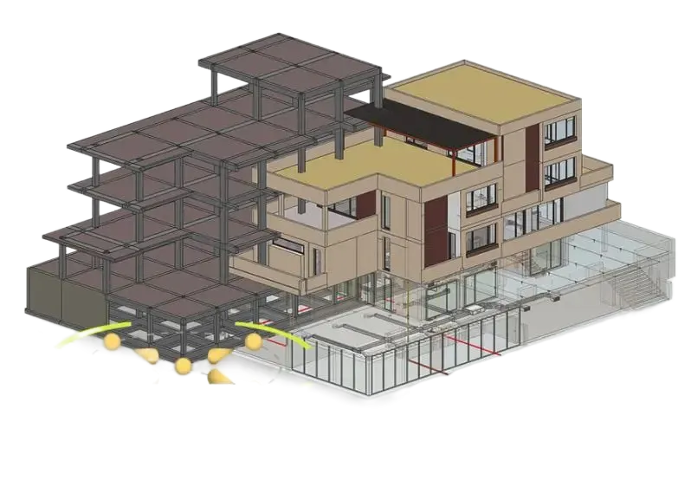
The Daily Bottleneck
■
Tedious Repetition: Manually creating and locking every view you open
■
Wasted Processing Time: doing this for each model you open
■
Human Error: Sometimes not locking and other people start to edit it
Navisworks
Naviswork
Navisworks.

Slide 9
The VDC Workflow
1. Dynamo Graph
2. Run the script
3. Check the result
Update the Name to Your Linking
click on the run button
check at least one revit model

Slide 10
Coordination Impact
Focus on Coordination, Not Repetitive Tasks
90%
by simply hitting this run button in dynamo you do not have to worry about how your view getting adjusted
Team awareness about the coordination view

Slide 11
Grab the Workflow
Download the Dynamo script and the Presentation for this episode.
linkedin.com/in/arch-youssef
github.com/ArchYoussefAdel/BIM-and-YOU

Slide 12
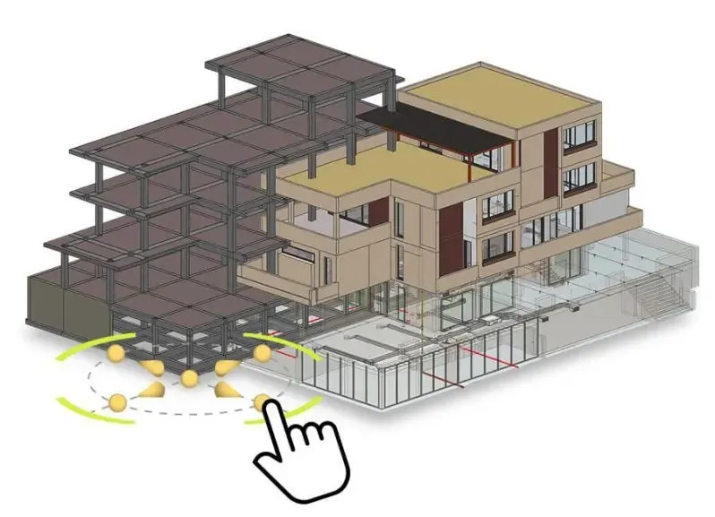
Sources
https://biblus.accasoftware.com/es/wp-content/uploads/sites/3/2020/10/federacion-de-modelos-con-usBIM.jpg.webp
biblus.acca software

Slide 13
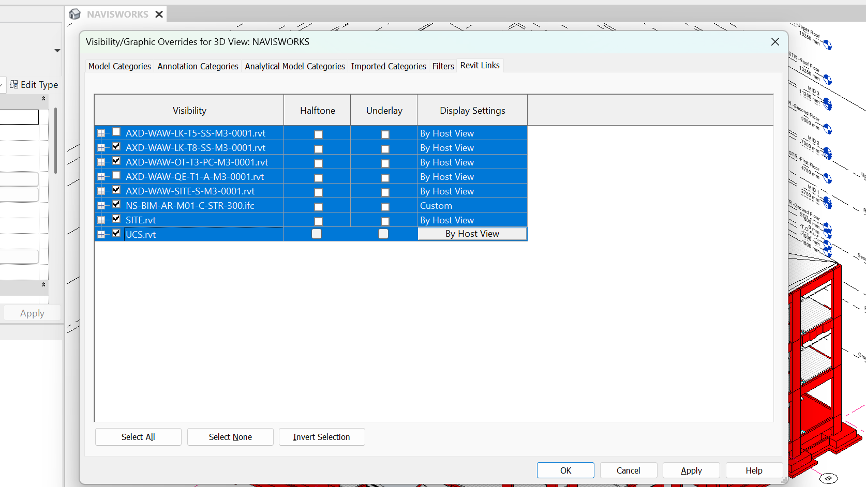
X
BIM && YOU
EP.02: 1-Click Model Prep: Batch-Hiding Revit Links for Navisworks

Slide 14
BIM && YOU
EP.02: 1-Click Model Prep: Batch-Hiding Revit Links for Navisworks
Thanks for watching!
👍 Like & Comment: What workflow should I automate next?
📥Free Dynamo Script & Presentation pinned in comments.
Youssef Adel | Senior BIM Coordinator

